Slide 1
John F. Kennedy
From Wikipedia, the free encyclopedia
https://en.wikipedia.org/wiki/John%20F.%20Kennedy
Licensed under CC BY-SA 3.0:
https://en.wikipedia.org/wiki/Wikipedia:Text_of_Creative_Commons_Attribution-ShareAlike_3.0_Unported_License

Slide 2
John F. Kennedy
Kennedy's time in office was marked by high tensions with communist states in the Cold War.
On November 22, 1963, Kennedy was assassinated in Dallas, Texas.
Vice President Lyndon Johnson automatically assumed the presidency upon Kennedy's death.
Kennedy continues to rank highly in polls of U.S. presidents with historians and the general public.

Slide 3
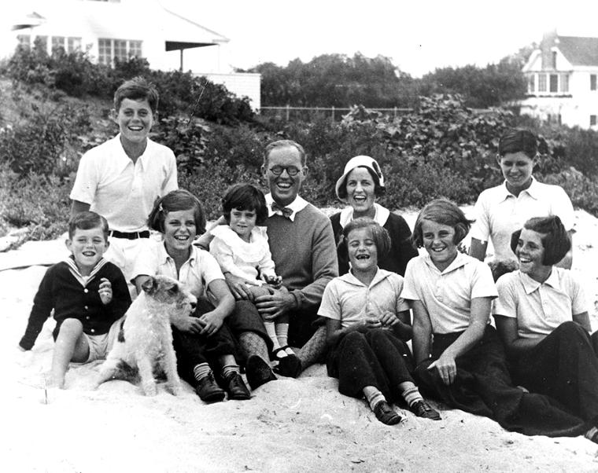
The Kennedy family at Hyannis Port, Massachusetts, in 1931 with Jack at top left in the white shirt.

Slide 4
Early life and education
John Fitzgerald Kennedy was born on May 29, 1917, at 83 Beals Street in suburban Brookline, Massachusetts, to businessman/politician Joseph Patrick "Joe" Kennedy and philanthropist/socialite Rose Elizabeth Fitzgerald Kennedy.
Kennedy's maternal grandfather and namesake John F. Fitzgerald served as a U.S.

Slide 5
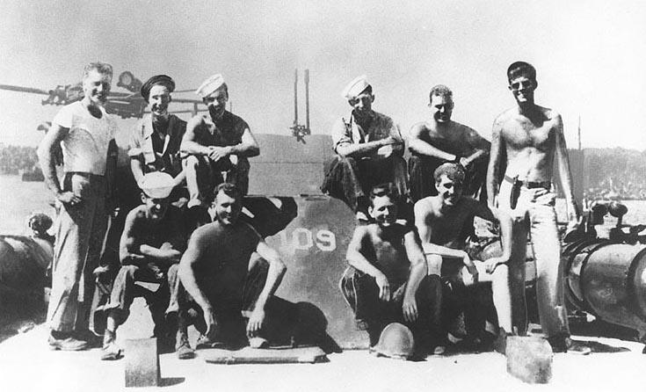
Lieutenant (junior grade) Kennedy (standing at right) with his PT-109 crew, 1943

Slide 6
U.S. Navy Reserve (1941–1945)
In January 1942, Kennedy was assigned to the ONI field office at Headquarters, Sixth Naval District, in Charleston, South Carolina.
Two decades later, Kennedy and Koehler's stepson, U.S.
Kennedy completed his training on December 2 and was assigned to Motor Torpedo Squadron FOUR.
Thereafter, Kennedy was assigned duty in Panama and later in the Pacific theater, where he eventually commanded two more PT boats.

Slide 7
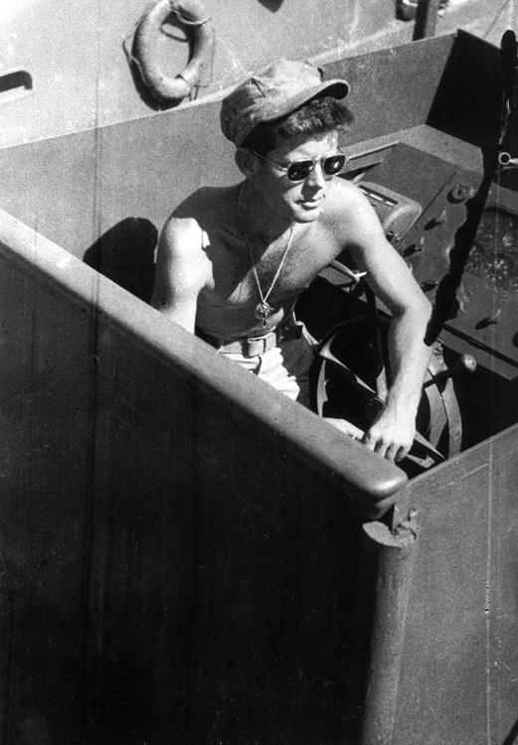
Kennedy on his navy patrol boat, the PT-109, 1943

Slide 8
Commanding the PT-109
In April 1943, Kennedy was assigned to Motor Torpedo Squadron TWO.
Kennedy stated: "There's nothing in the book about a situation like this.
Kennedy and Ross found a small canoe, packages of crackers, candy and a fifty-gallon drum of drinkable water left by the Japanese, which Kennedy paddled another half mile back to Olasana in the acquired canoe to provide his hungry crew.

Slide 9
Commanding the PT-59
Kennedy took only a month to recover.
On October 8, Kennedy was promoted to full lieutenant.
Kennedy was hospitalized at the Chelsea Naval Hospital in Chelsea, Massachusetts from May to December 1944.
Kennedy's two original medals are currently on display at the John F. Kennedy Presidential Library and Museum.
When later asked how he became a war hero, Kennedy joked: "It was easy.

Slide 10
Military awards
Kennedy's military decorations and awards include the Navy and Marine Corps Medal; Purple Heart Medal; American Defense Service Medal; American Campaign Medal; Asiatic-Pacific Campaign Medal with three ​3⁄16" bronze stars; and the World War II Victory Medal.

Slide 11
Journalism
In April 1945, Kennedy's father, who was a friend of William Randolph Hearst, arranged a position for his son as a special correspondent for Hearst Newspapers; the assignment kept Kennedy's name in the public eye and "expose[d] him to journalism as a possible career."

Slide 12
Congressional career (1947–1960)
Joe's death during the war in 1944 changed that course and the task now fell to the second eldest of the Kennedy siblings – John F. Kennedy.

Slide 13
House of Representatives (1947–1953)
Kennedy established his residency at an apartment building on 122 Bowdoin Street across from the Massachusetts State House.
With his father financing and running his campaign under the slogan "The New Generation Offers a Leader", Kennedy won the Democratic primary with 12 percent of the vote, defeating ten other candidates.
Along with Richard Nixon and Joseph McCarthy, Kennedy was one of several World War II veterans first elected to Congress that year.

Slide 14
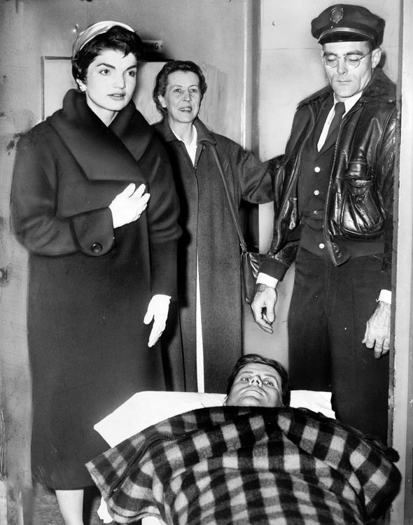
Kennedy lying on a gurney following spinal surgery, accompanied by Jackie, December 1954

Slide 15
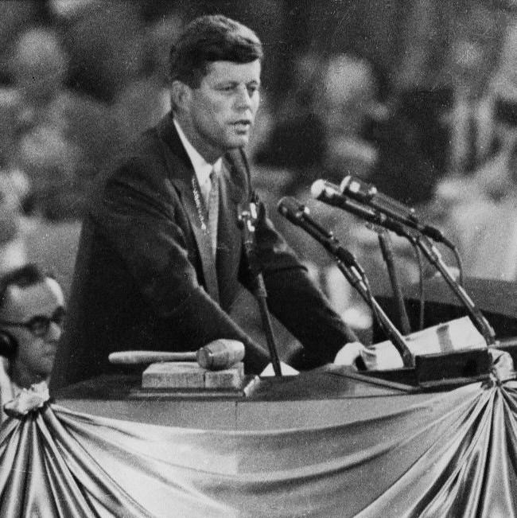
Kennedy endorsing Adlai Stevenson II for the presidential nomination at the 1956 Democratic National Convention in Chicago

Slide 16
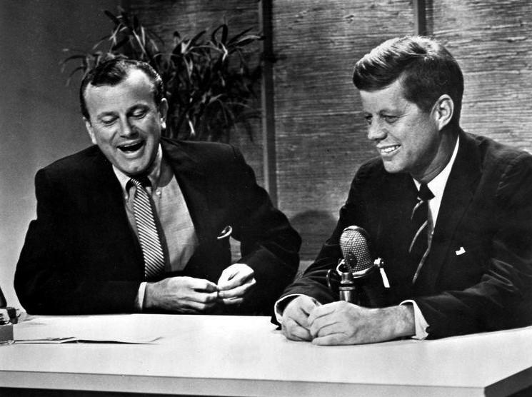
Jack Paar interviews Senator Kennedy on The Tonight Show (1959)

Slide 17
Senate (1953–1960)
Joseph Kennedy again financed and managed his son's candidacy, while John Kennedy's younger brother Robert Kennedy emerged as an important member of the campaign.
While Kennedy's father was a strong supporter of Senator Joseph McCarthy, McCarthy was also a friend of the Kennedy family.
Additionally, Bobby Kennedy worked for McCarthy's subcommittee, and McCarthy dated Kennedy's sister Patricia.

Slide 18
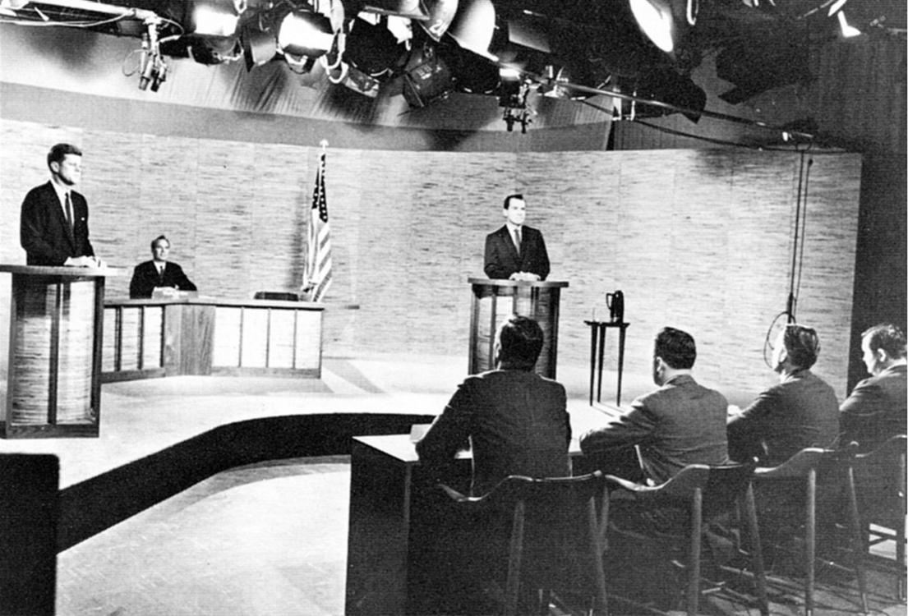
Kennedy and Richard Nixon participate in the nation's first televised presidential debate, Washington, D.C., 1960

Slide 19
1960 presidential election
Nonetheless, Kennedy and Humphrey faced each other in a competitive West Virginia primary in which Kennedy could not benefit from a Catholic bloc, as he had in Wisconsin.
Kennedy's candidacy also faced opposition from former president Harry S. Truman, who was concerned about Kennedy's lack of experience.

Slide 20
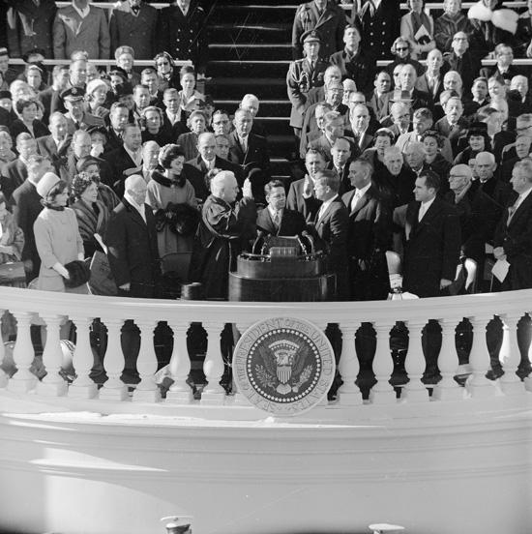
Chief Justice Earl Warren administers the Presidential oath of office to John F. Kennedy at the Capitol, January 20, 1961.

Slide 21
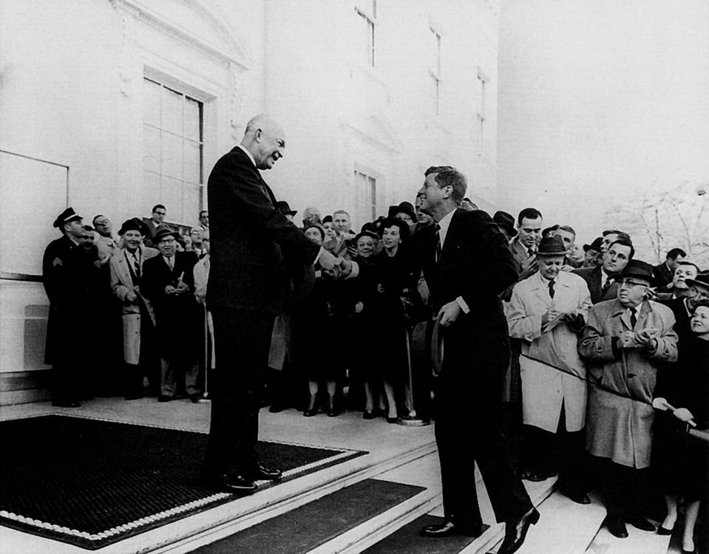
Outgoing President Dwight D. Eisenhower meets with President-elect John F. Kennedy on December 6, 1960

Slide 22
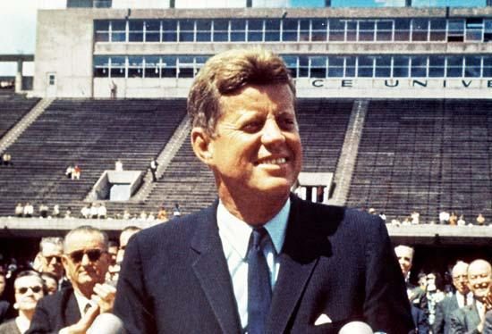
John F. Kennedy speaking at Rice University in Houston on September 12, 1962.

Slide 23
Presidency (1961–1963)
John F. Kennedy was sworn in as the 35th president at noon on January 20, 1961.
Kennedy preferred the organizational structure of a wheel with all the spokes leading to the president.
It recorded many conversations with Kennedy and his Cabinet members, including those in relation to the "Cuban Missile Crisis".

Slide 24
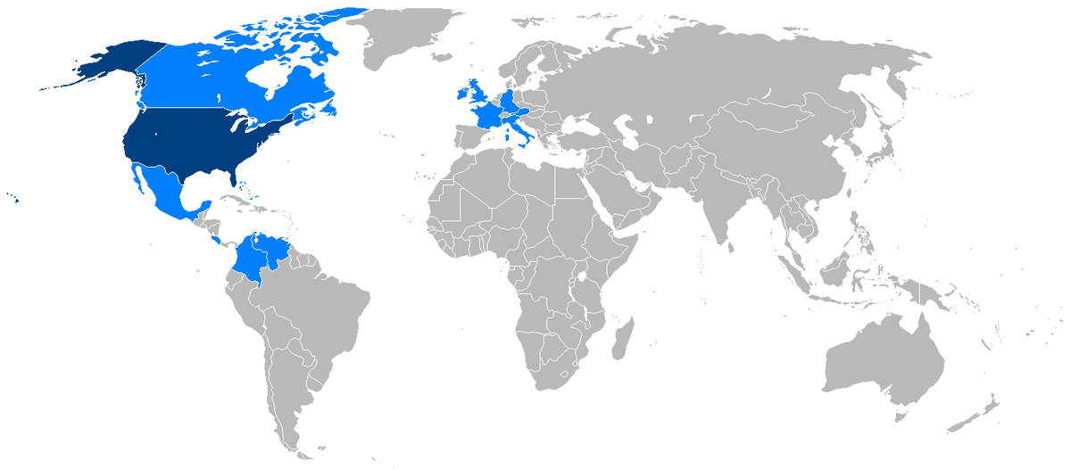
Foreign trips of John F. Kennedy during his presidency

Slide 25
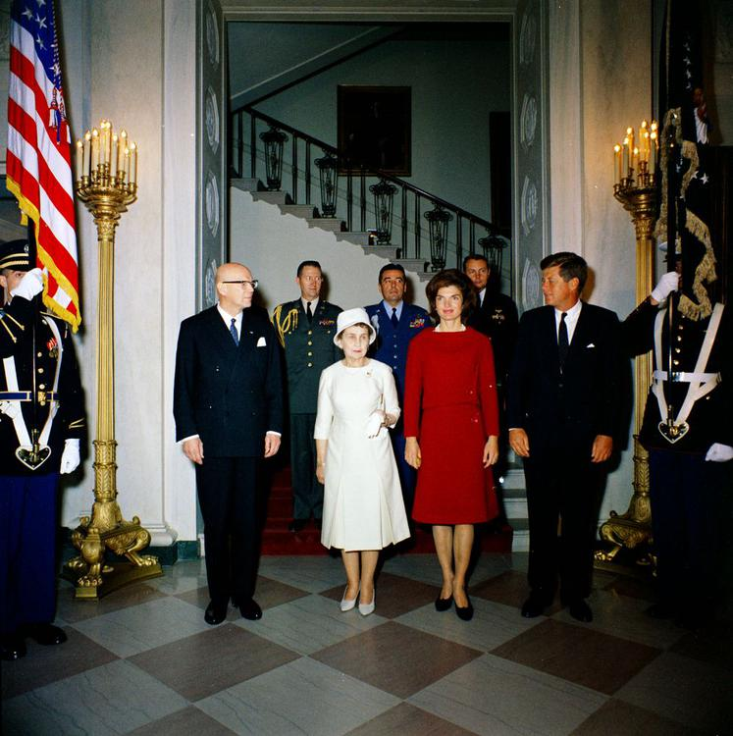
From left: President Urho Kekkonen, Sylvi Kekkonen, Jacqueline Kennedy Onassis and John F. Kennedy.

Slide 26
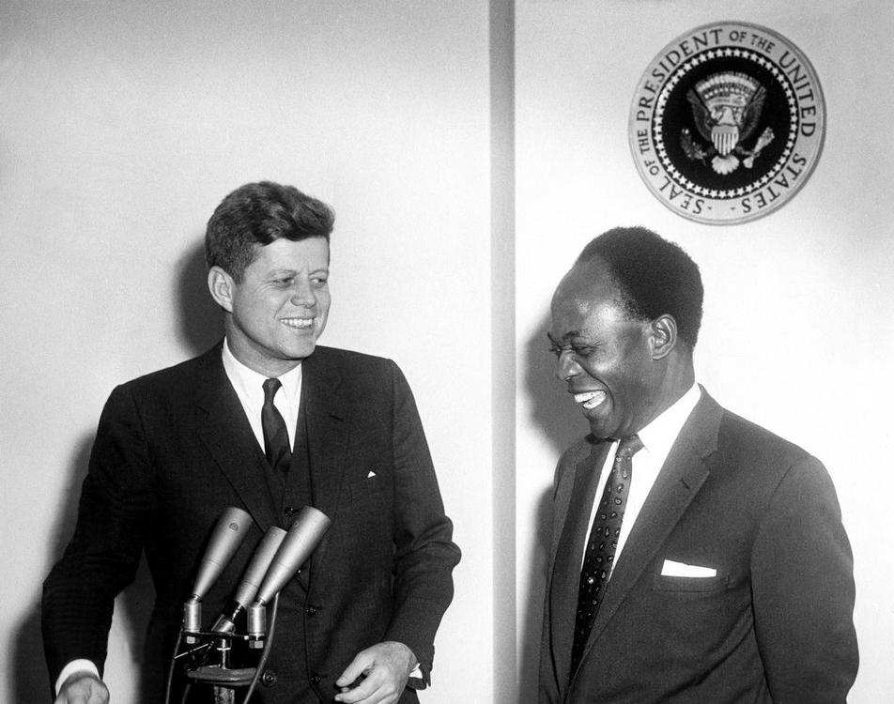
Kennedy with Kwame Nkrumah, the first head of an independent Ghana, March 1961

Slide 27
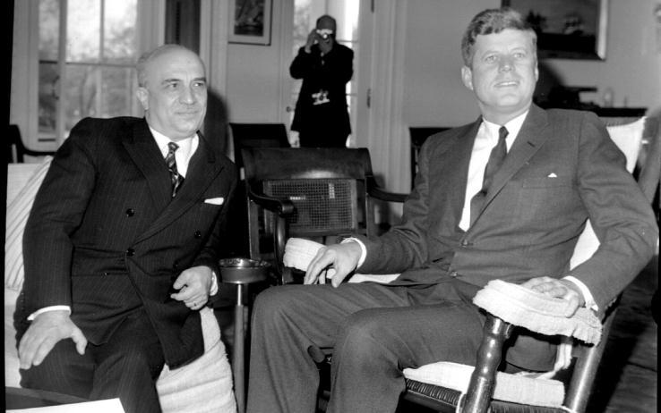
Kennedy with the Italian Prime Minister Amintore Fanfani, at the White House, in 1963

Slide 28
Foreign policy
President Kennedy's foreign policy was dominated by American confrontations with the Soviet Union, manifested by proxy contests in the early stage of the Cold War.
Kennedy picked up on this in his speech in Paris, saying that he would be remembered as "the man who accompanied Jackie Kennedy to Paris."

Slide 29
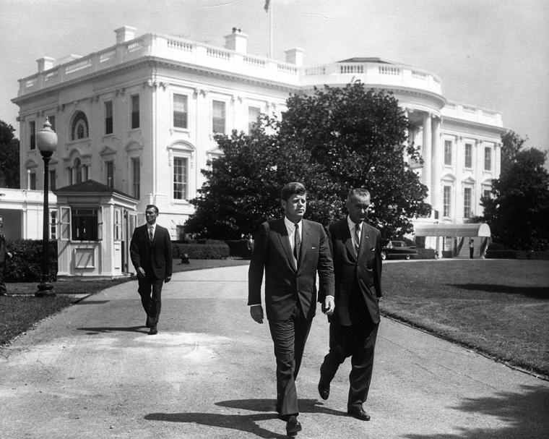
The President and Vice President take a leisurely stroll on the White House grounds

Slide 30
Cuba and the Bay of Pigs Invasion
Kennedy approved the final invasion plan on April 4, 1961.
By April 19, 1961, the Cuban government had captured or killed the invading exiles, and Kennedy was forced to negotiate for the release of the 1,189 survivors.
Biographer Richard Reeves said that Kennedy focused primarily on the political repercussions of the plan rather than military considerations.

Slide 31
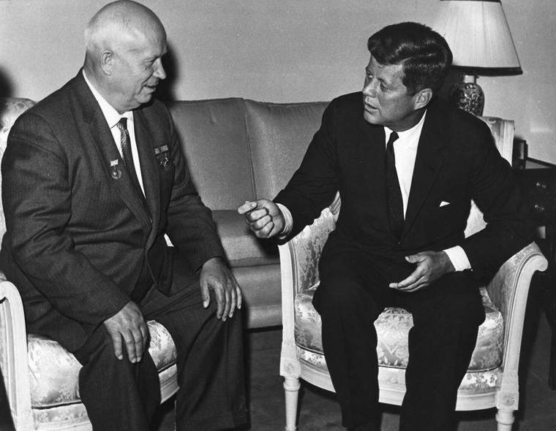
Soviet Premier Nikita Khrushchev and Kennedy confer in Vienna, 1961

Slide 32
Cuban Missile Crisis
On a personal level, Kennedy needed to show resolve in reaction to Khrushchev, especially after the Vienna summit.
In concurrence with a majority-vote of the NSC, Kennedy decided on a naval quarantine.
Khrushchev agreed, but Kennedy didn't.
Kennedy's approval rating increased from 66% to 77% immediately thereafter.

Slide 33
Latin America and communism
When President Kennedy took office, he privately instructed the CIA that any plan must include plausible deniability by the U.S. His public position was in opposition.
Robert Kennedy, who saw an opportunity for the U.S., called Bowles "a gutless bastard" to his face.

Slide 34
Peace Corps
In one of his first presidential acts, Kennedy asked Congress to create the Peace Corps.

Slide 35
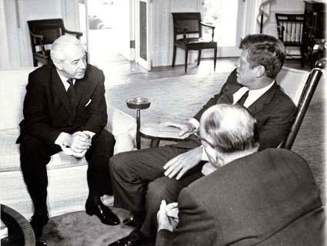
Kennedy with future Australian Prime Minister Harold Holt in the Oval Office in 1963

Slide 36
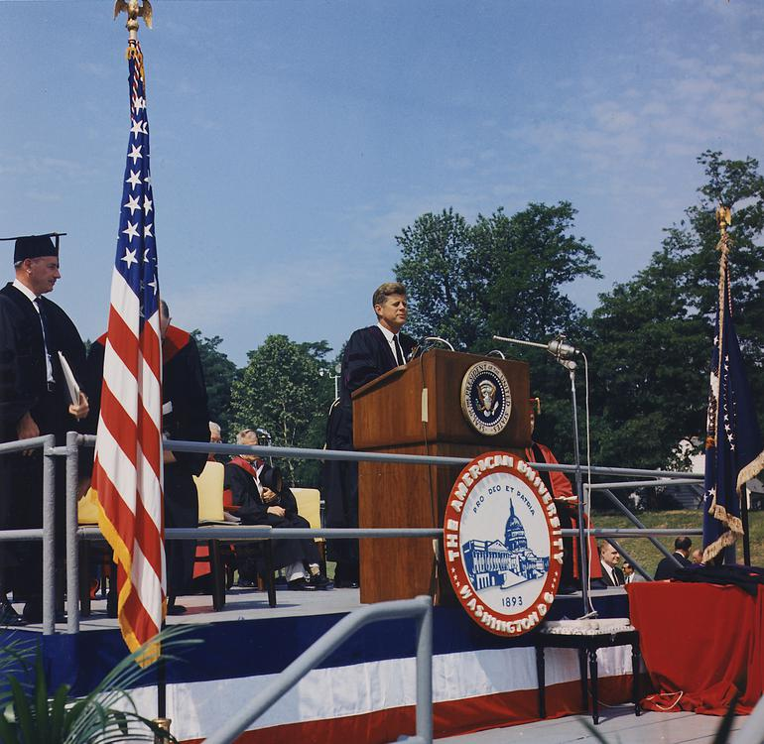
Kennedy delivers the commencement speech at American University, June 10, 1963

Slide 37
Southeast Asia
It was approved by Kennedy and South Vietnam President Ngo Dinh Diem.
Kennedy reacted, asking, "Did you two gentlemen visit the same country?"
Kennedy was shocked by the deaths.
At the time of Kennedy's death, no final policy decision was made to Vietnam.
After Kennedy's assassination, President Johnson signed NSAM 273 on November 26, 1963.

Slide 38
American University speech
On June 10, 1963, Kennedy, at the high point of his rhetorical powers, delivered the commencement address at American University in Washington, D.C. Also known as "A Strategy of Peace", not only did the President outline a plan to curb nuclear arms, but he also "laid out a hopeful, yet realistic route for world peace at a time when the U.S. and Soviet Union faced the potential for an escalating nuclear arms race."
The President wished:
The president also made two announcements— 1.)

Slide 39
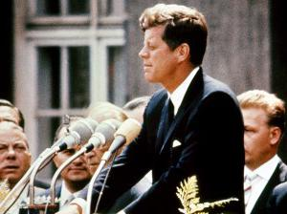
Kennedy delivering his speech in West Berlin

Slide 40
West Berlin speech
To Kennedy's eyes, this Franco-German cooperation seemed directed against NATO's influence in Europe.
On June 26, President Kennedy gave a public speech in West Berlin.
Kennedy used the construction of the Berlin Wall as an example of the failures of communism: "Freedom has many difficulties, and democracy is not perfect.
Kennedy remarked to Ted Sorensen afterwards: "We'll never have another day like this one, as long as we live."

Slide 41
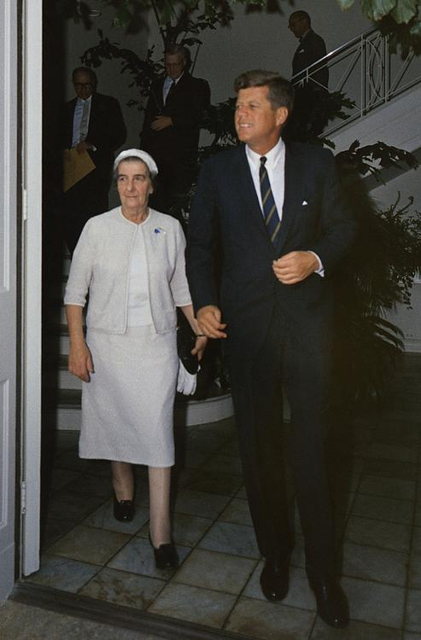
Kennedy with Israeli Foreign Minister Golda Meir, December 27, 1962

Slide 42
Israel
In 1960 Kennedy stated, "Israel will endure and flourish.
Kennedy ended the arms embargo that the Eisenhower and Truman administrations had enforced on Israel.
When Ben-Gurion met with Kennedy in New York, he claimed that Dimona was being developed to provide nuclear power for desalinization and other peaceful purposes "for the time being."
Israeli lobbyist Abe Feinberg stated: "It was part of my job to tip them off that Kennedy was insisting on [an inspection]."

Slide 43
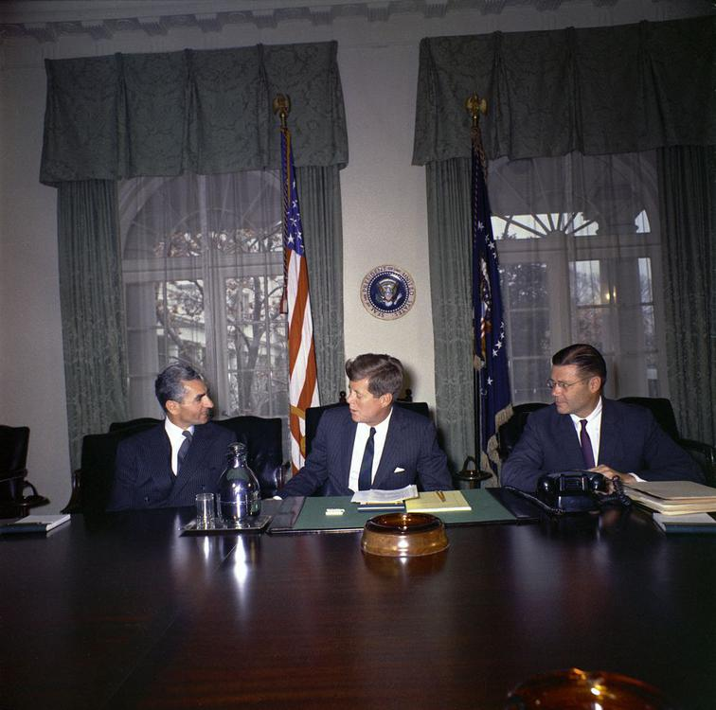
Mohammad Reza Pahlavi, Shah of Iran, Kennedy, and U.S. Defense Secretary Robert McNamara in the White House Cabinet Room on April 13, 1962

Slide 44
Iraq
At the same time, Kennedy dispatched a U.S. Navy task force to Bahrain, and the UK (at the urging of the Kennedy administration) brought the dispute to United Nations Security Council, where the proposed resolution was vetoed by the Soviet Union.
The Kennedy administration was pleased with the outcome and ultimately approved a $55-million arms deal for Iraq.

Slide 45
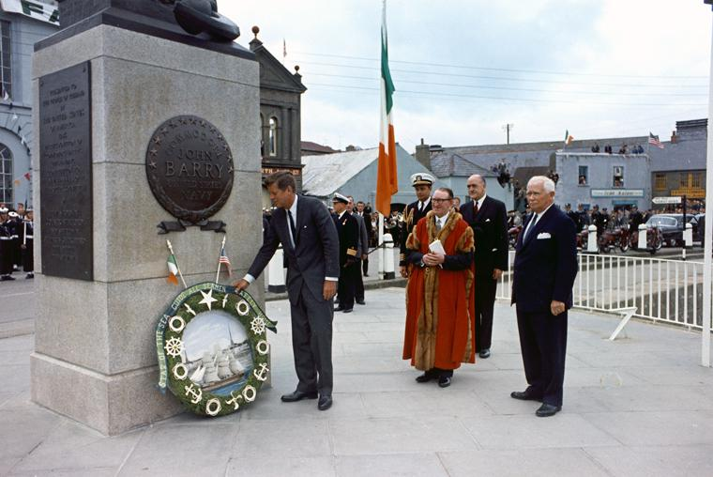
John F. Kennedy visiting the John Barry Memorial at Crescent Quay in Wexford, Ireland

Slide 46
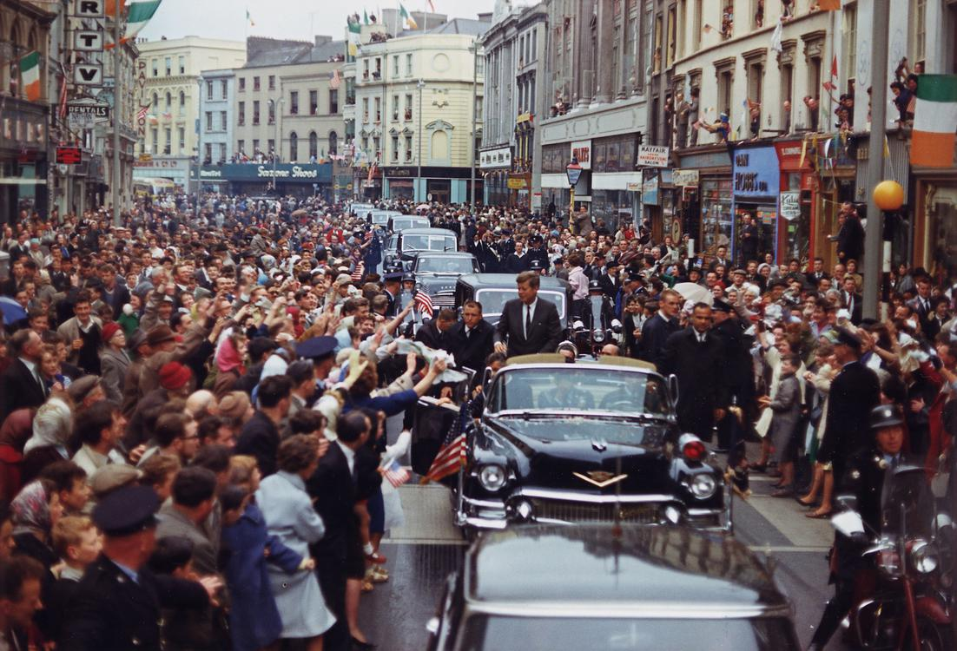
President Kennedy in motorcade in Patrick Street, Cork, in Ireland on June 28, 1963

Slide 47
Ireland
Kennedy also was the first foreign leader to address the Houses of the Oireachtas (the Irish parliament).
On December 22, 2006, the Irish Department of Justice released declassified police documents indicating that security was heightened as Kennedy was the subject of three death threats during this visit.

Slide 48
Nuclear Test Ban Treaty
In their Vienna summit meeting in June 1961, Khrushchev and Kennedy both reached an informal understanding against nuclear testing, but the Soviet Union began testing nuclear weapons that September.
In July 1963, Kennedy sent W. Averell Harriman to Moscow to negotiate a treaty with the Soviets.
The U.S. Senate ratified this and Kennedy signed it into law in October 1963.

Slide 49
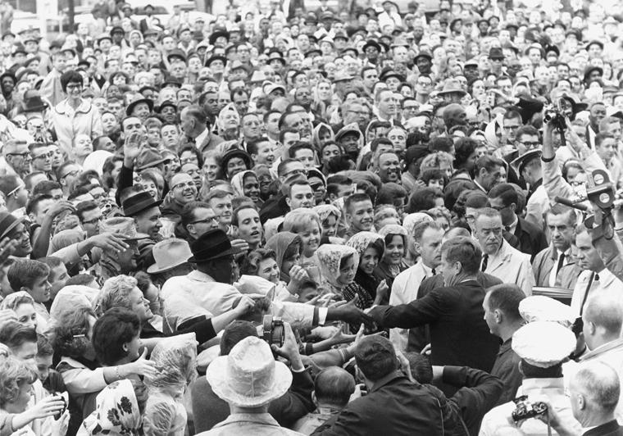
President Kennedy in Fort Worth, Texas, on Friday morning, November 22, 1963

Slide 50
Domestic policy
Kennedy called his domestic program the "New Frontier".
Kennedy added that the top rate should be set at 70% if certain deductions were not eliminated for high income earners.
Congress passed few of Kennedy's major programs during his lifetime, but did vote them through in 1964 and 1965 under his successor Johnson.

Slide 51
Economy
The economy, which had been through two recessions in three years and was in one when Kennedy took office, accelerated notably throughout his administration.
The economy turned around and prospered during Kennedy's years as President.
Attorney General Robert Kennedy took the position that steel executives had illegally colluded to fix prices.

Slide 52
Federal and military death penalty
During his administration, Kennedy oversaw the last federal execution prior to Furman v. Georgia, a 1972 case that led to a moratorium on federal executions.
Kennedy commuted a death sentence imposed by a military court on seaman Jimmie Henderson on February 12, 1962, changing the penalty to life in prison.

Slide 53
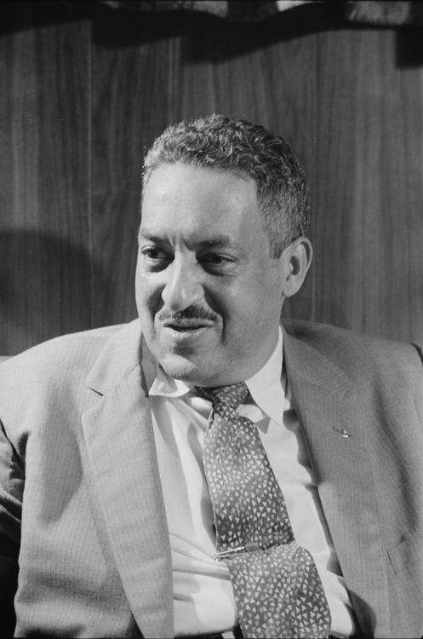
Thurgood Marshall, appointed to the bench by Kennedy in May 1961

Slide 54
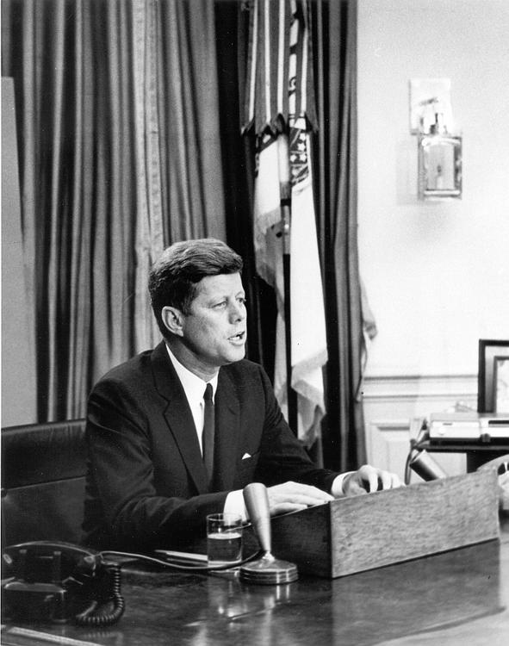
Kennedy's Report to the American People on Civil Rights, June 11, 1963

Slide 55
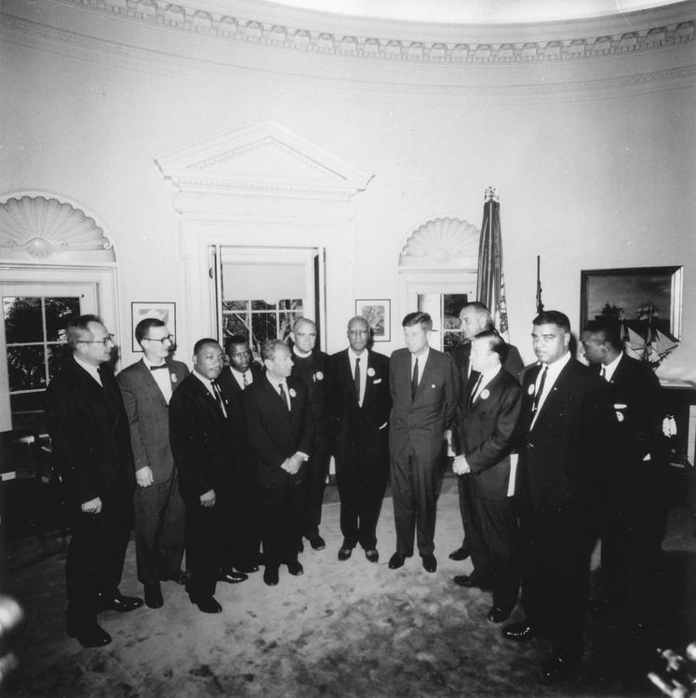
Kennedy meets with leaders of the March on Washington in the Oval Office, August 28, 1963

Slide 56
Civil Rights Movement
Kennedy did not execute the order.
In response to that, Robert Kennedy, now U.S. Attorney General, sent 400 federal marshals, while President Kennedy reluctantly sent 3,000 troops after the situation on campus turned out violent.
When Arthur M. Schlesinger Jr. complimented Kennedy on his remarks, Kennedy bitterly replied, "Yes, and look at what happened to area development the very next day in the House."
Kennedy watched King's speech on TV and was very impressed.

Slide 57
Civil liberties
Robert Kennedy and the president also both warned King to discontinue the suspect associations.
After the associations continued, Robert Kennedy issued a written directive authorizing the FBI to wiretap King and other leaders of the Southern Christian Leadership Conference, King's civil rights organization, in October 1963.

Slide 58
Immigration
During the 1960 campaign Kennedy proposed an overhaul of American immigration and naturalization laws to ban discrimination based on national origin.
The late-president's brother, Senator Edward Kennedy helped steer the legislation through the Senate.

Slide 59
Native American relations
Kennedy was asked by the American Civil Liberties Union to intervene and to halt the project, but he declined, citing a critical need for flood control.

Slide 60
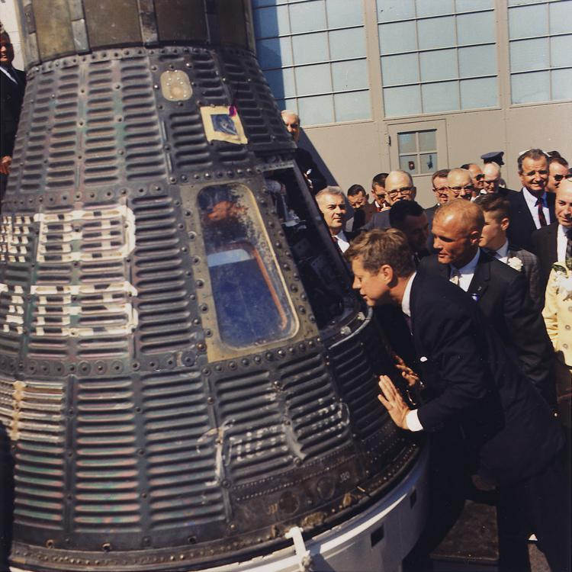
Accomplanied by astronaut John Glenn, Kennedy inspects the Project Mercury capsule Friendship 7, 23 February 1962

Slide 61
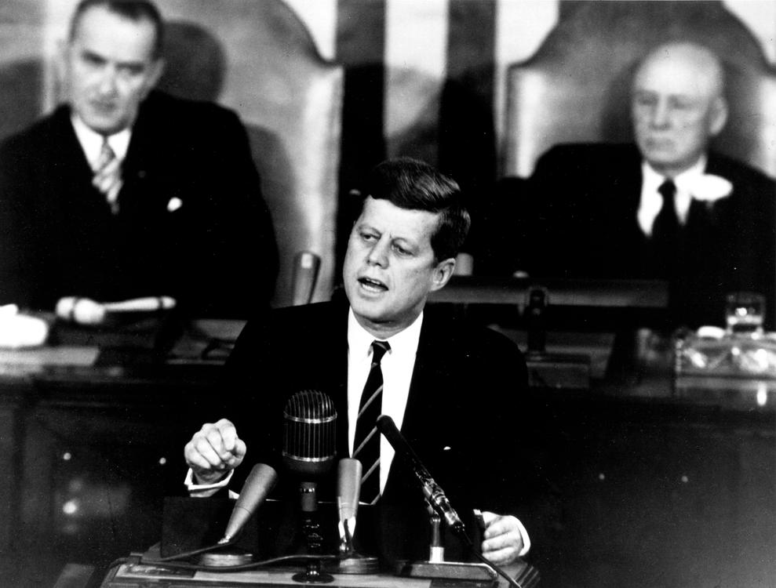
Kennedy proposing a program to Congress that will land men on the Moon, May 1961.

Slide 62
Space policy
As senator, Kennedy had been opposed to the space program and wanted to terminate it.
In Kennedy's January 1961 State of the Union address, he had suggested international cooperation in space.
Kennedy's advisor Ted Sorensen advised him to support the Moon landing, and on May 25, Kennedy announced the goal in a speech titled "Special Message to the Congress on Urgent National Needs":

Slide 63
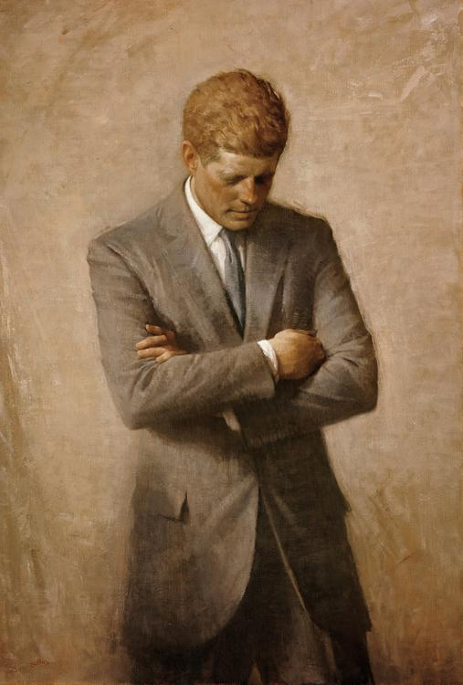
The official White House portrait of John F. Kennedy, painted by Aaron Shikler

Slide 64
Supreme Court
Kennedy appointed the following Justices to the Supreme Court of the United States:

Slide 65
Other courts
In addition to his two Supreme Court appointments, Kennedy appointed 21 judges to the United States Courts of Appeals, and 102 judges to the United States district courts.

Slide 66
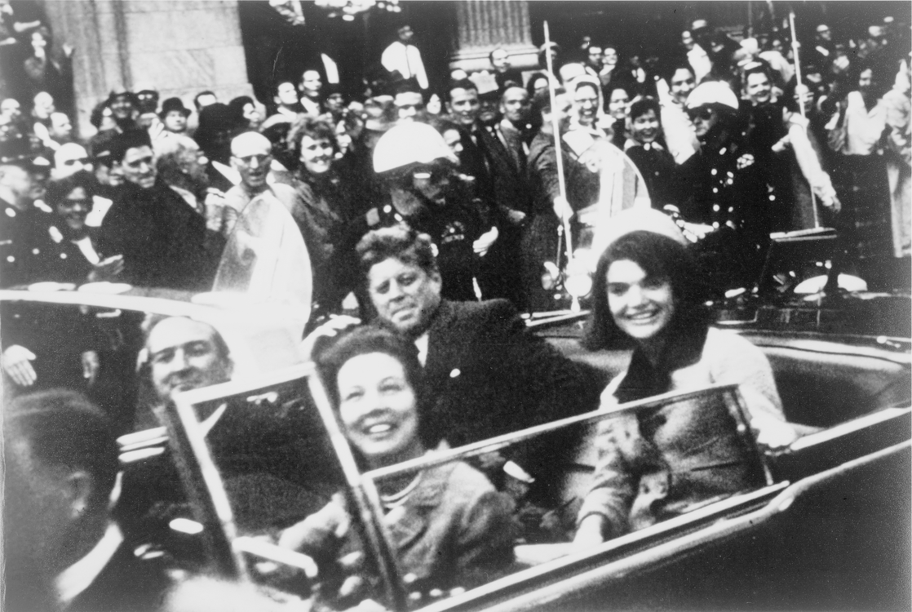
The Kennedys and the Connallys in the presidential limousine moments before the assassination in Dallas

Slide 67
Assassination
President Kennedy was assassinated in Dallas, Texas, at 12:30 pm Central Standard Time on Friday, November 22, 1963.
Tippit, and was subsequently charged with Kennedy's assassination.
The commission concluded that Oswald acted alone in killing Kennedy and that Oswald was not part of any conspiracy.
In 1979 the U.S. House Select Committee on Assassinations concluded that it believed "that Kennedy was probably assassinated as a result of a conspiracy.

Slide 68
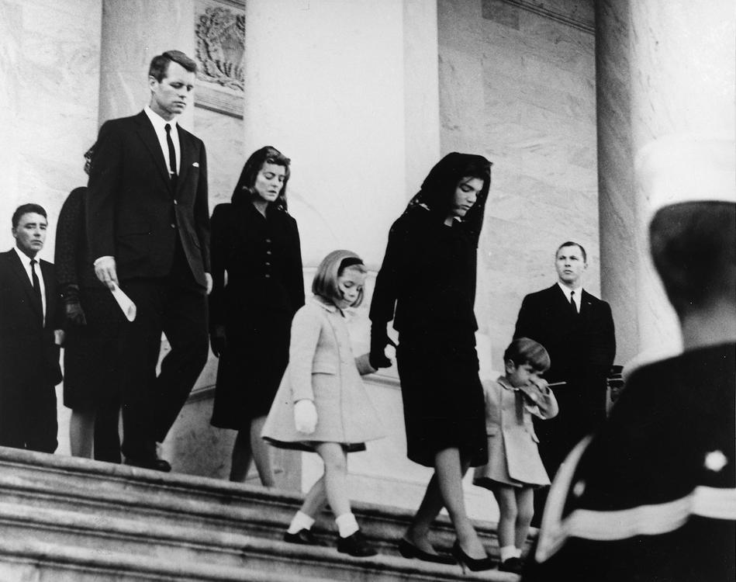
President Kennedy's family leaving his funeral at the U.S. Capitol Building

Slide 69
Funeral
It was from this memorial that the graves of both Robert and Ted Kennedy were modeled.
Kennedy was greatly impressed by the Irish Cadets on his last official visit to Ireland, so much so that Jacqueline Kennedy requested the Irish Army to be the honor guard at her husband's funeral.
Kennedy's brother Robert was buried nearby in June 1968.
John F. Kennedy's grave is lit with an "Eternal Flame".
Kennedy and William Howard Taft are the only two U.S. presidents buried at Arlington.

Slide 70
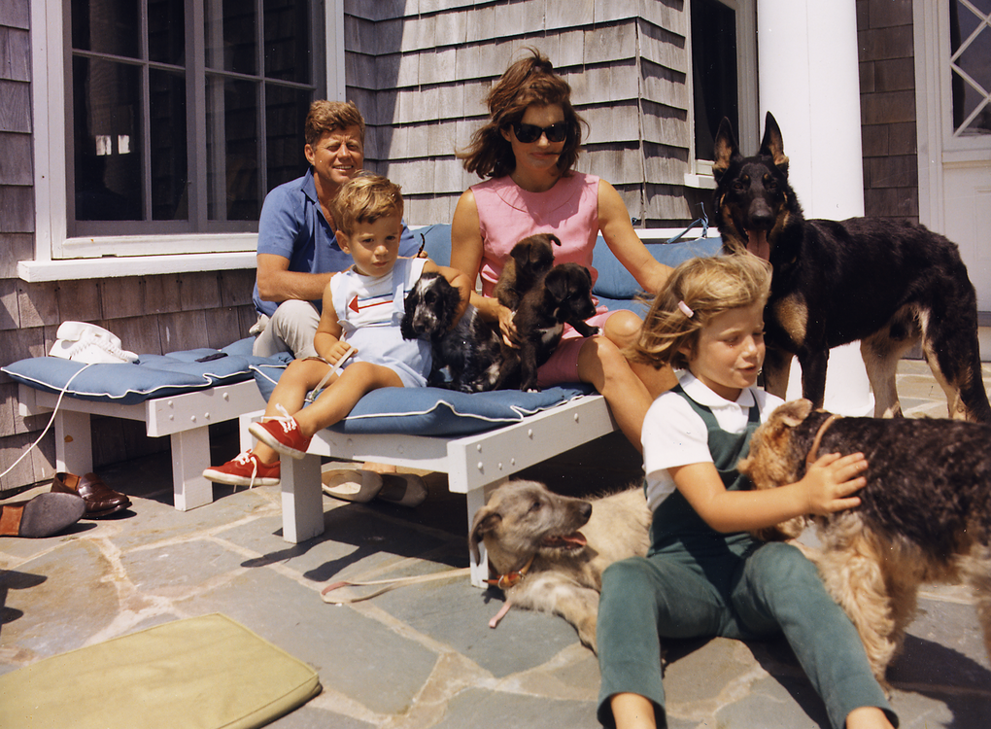
The Kennedy family in Hyannis Port, Massachusetts, in 1963

Slide 71
Personal life, family, and reputation
The Kennedy family is one of the most established political families in the United States, having produced a president, three senators, three ambassadors, and multiple other representatives and politicians, both at the federal and state level.
Bobby would later run for president in 1968 before his assassination, while another Kennedy brother, Ted, ran for president in 1980.
Kennedy was a life member of the National Rifle Association.

Slide 72
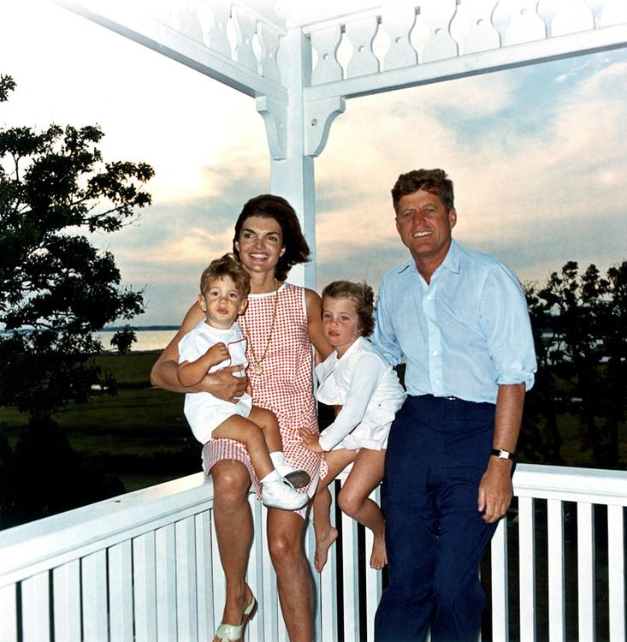
The First Family in 1962

Slide 73
Wife and children
Kennedy met his future wife, Jacqueline Lee "Jackie" Bouvier (1929–1994), when he was a congressman.
John Fitzgerald Kennedy Jr., nicknamed "John-John" by the press as a child, was born in late November 1960, 17 days after his father was elected.

Slide 74
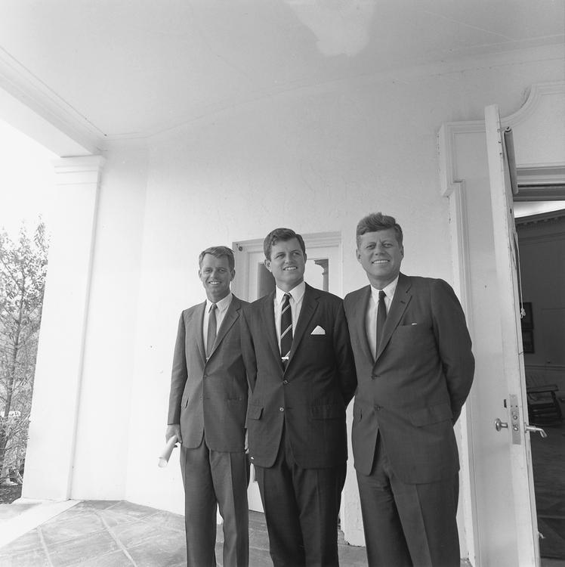
The Kennedy brothers: Attorney General Robert F. Kennedy, Senator Ted Kennedy, and President John F. Kennedy in 1963

Slide 75
Popular image
Although Eisenhower had allowed presidential press conferences to be filmed for television, Kennedy was the first president to ask for them to be broadcast live and made good use of the medium.
In 1961 the Radio-Television News Directors Association presented Kennedy with its highest honor, the Paul White Award, in recognition of his open relationship with the media.
Mrs. Kennedy brought new art and furniture to the White House, and directed its restoration.

Slide 76
"Camelot Era"
The term "Camelot" came to be used retrospectively as iconic of the Kennedy administration, and the charisma of Kennedy and his family.

Slide 77
Health
In 1966 Dr. Travell revealed that Kennedy also had hypothyroidism.
Details of these and other medical problems were not publicly disclosed during Kennedy's lifetime.
Dr. Nassir Ghaemi, a physician who reviewed Kennedy's medical records in his presidential archives, has opined that Kennedy's leadership (e.g.

Slide 78
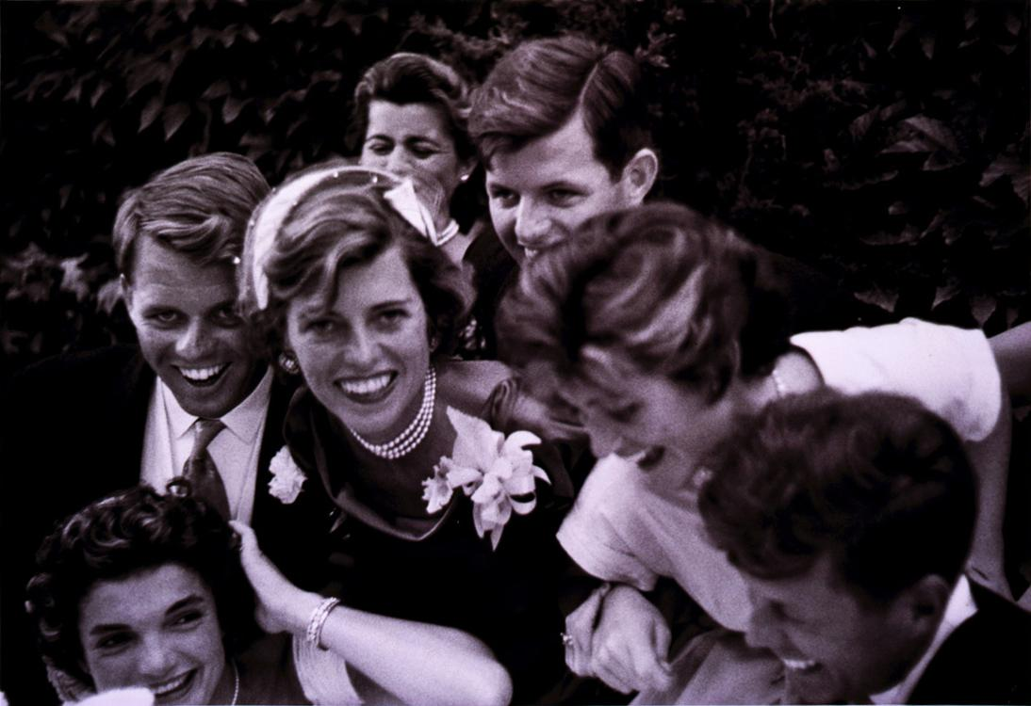
The newlyweds are surrounded by Jack's siblings on their wedding day in Newport, Rhode Island, 1953

Slide 79
Personal tragedies
Kennedy and his family have experienced a number of personal tragedies.
Kennedy's younger sister Rose Marie "Rosemary" Kennedy was born in 1918 with intellectual disabilities and underwent a prefrontal lobotomy at age 23, leaving her incapacitated for the rest of her life, until her death in 2005.
A son, Patrick Bouvier Kennedy, died two days after birth in August 1963.

Slide 80
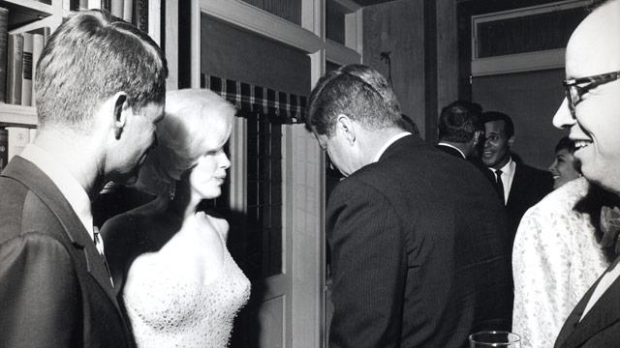
Attorney General Robert F. Kennedy, Marilyn Monroe, and John Kennedy talk during the president's 19 May, 1962 early birthday party where Monroe publicly serenaded JFK with "Happy Birthday, Mr. President"

Slide 81
Affairs, extramarital relationships and friendships
J. Edgar Hoover, the FBI director, received reports about Kennedy's indiscretions.
Kennedy inspired affection and loyalty from the members of his team and his supporters.
Lem Billings was a close and long-time friend of Kennedy and the Kennedy family.
Billings had his own room in which to stay at several Kennedy residences.

Slide 82
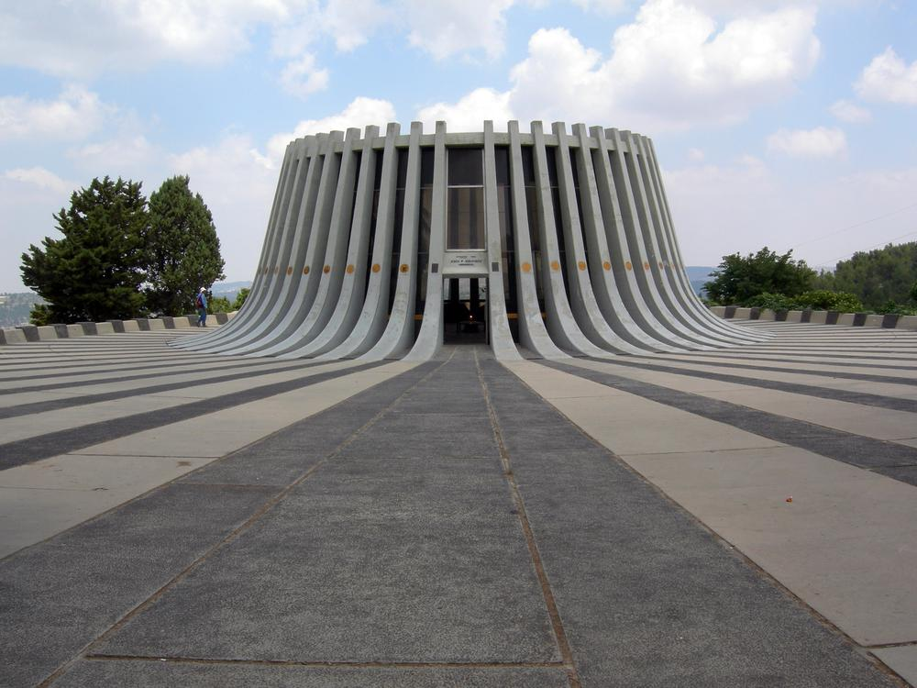
John F. Kennedy Memorial, near Jerusalem, Israel

Slide 83
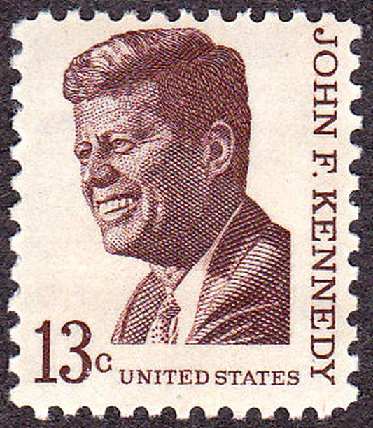
Kennedy on a U.S. postage stamp, issue of 1967

Slide 84
Historical evaluations and legacy
The US Special Forces had a special bond with Kennedy.
This bond was shown at Kennedy's funeral.
Kennedy is the only president who predeceased his mother and father.
Throughout the English-speaking world, the given name Kennedy has sometimes been used in honor of President Kennedy, as well his brother Robert.

Slide 85
Effect of assassination
Television was the primary source that kept people informed of the events that surrounded Kennedy's assassination.
On September 2, 1963, Kennedy helped inaugurate network television's first half-hour nightly evening newscast according to an interview with CBS Evening News anchor Walter Cronkite.
Many vividly remember where they were when they first learned the news that Kennedy was assassinated, as with the Japanese attack on Pearl Harbor on December 7, 1941, before it and the September 11 attacks after it.

Slide 86
Memorials and eponyms
John F. Kennedy International Airport, American airport in New York City; nation's busiest international gateway
John F. Kennedy School of Government, part of Harvard University
USS John F. Kennedy (CVN-79), U.S. Navy aircraft carrier that began construction in 2011, and is scheduled to be placed in commission in 2020

Slide 87
Primary sources
In a Perilous Hour: The Public Address of John F. Kennedy (1995, ISBN 978-0313277702)
Kennedy, Jacqueline.
Jacqueline Kennedy: Historic Conversations on Life with John F. Kennedy (2011, ISBN 1401324258).

Slide 88
Historiography and memory
The Kennedy Obsession: The American Myth of JFK (1997, ISBN 978-0231107983)
"An Idol and Once a President: John F. Kennedy at 100".
A Companion to John F. Kennedy (Wiley-Blackwell, 2014, ISBN 978-1444350364), Topical essays by scholars focusing on the historiography

Slide 89
External links
John F. Kennedy Presidential Library and Museum
"John F. Kennedy collected news and commentary".
"John F. Kennedy (id: K000107)".
Works by or about John F. Kennedy at Internet Archive
John F. Kennedy discography at Discogs
John F. Kennedy at Curlie
John F. Kennedy on IMDb

